Slide 1


Slide 2
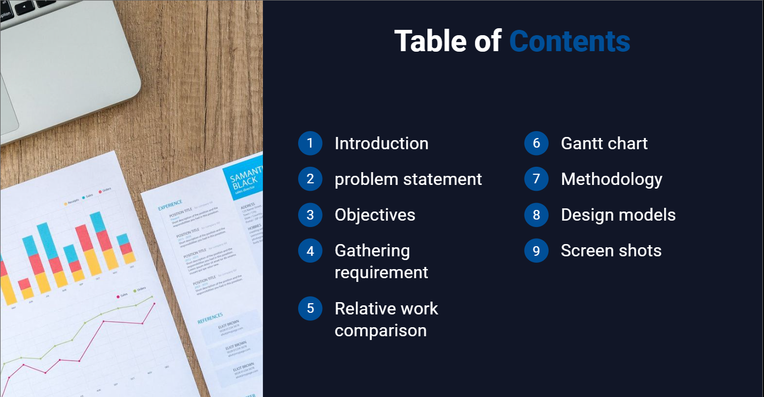

Slide 3


Slide 4


Slide 5


Slide 6


Slide 7
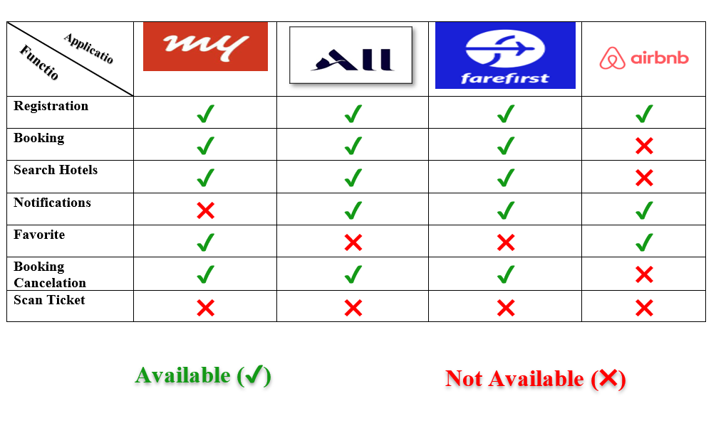
Relative work comparison

Slide 8
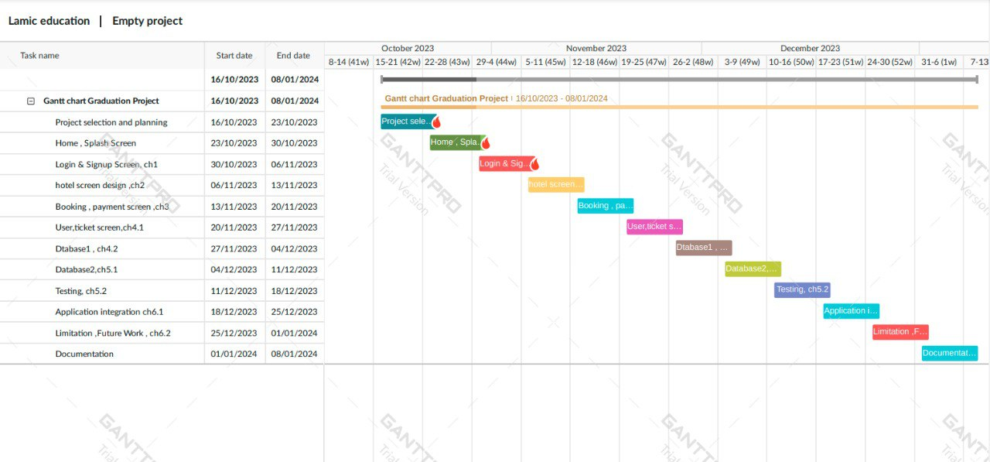
Gantt Chart

Slide 9


Slide 10
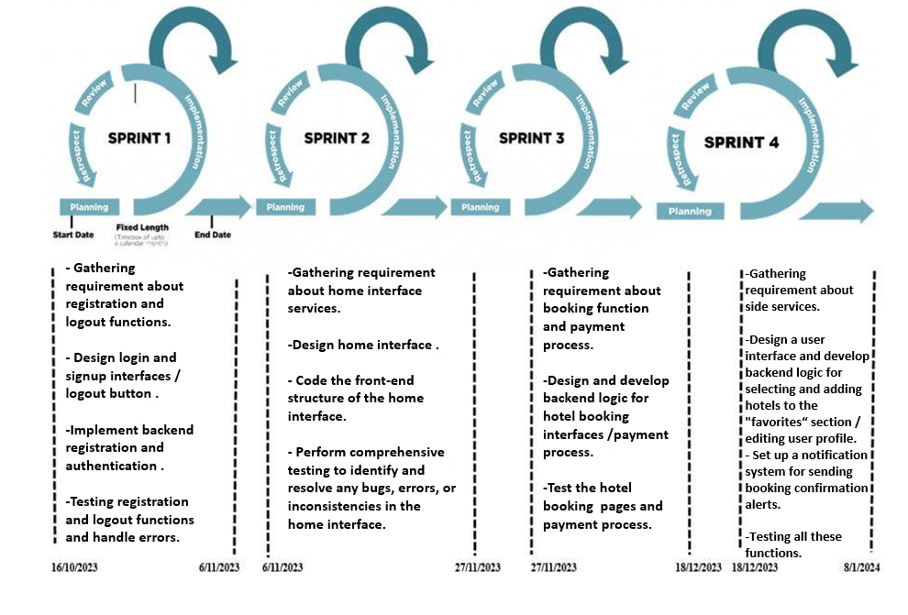

Slide 11
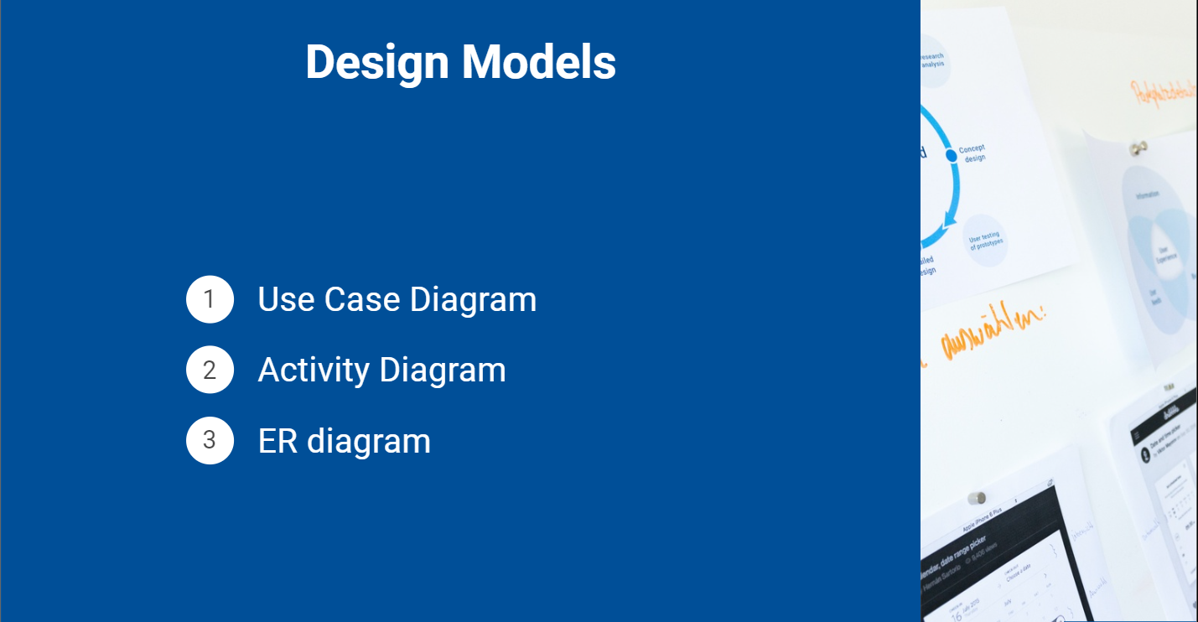

Slide 12
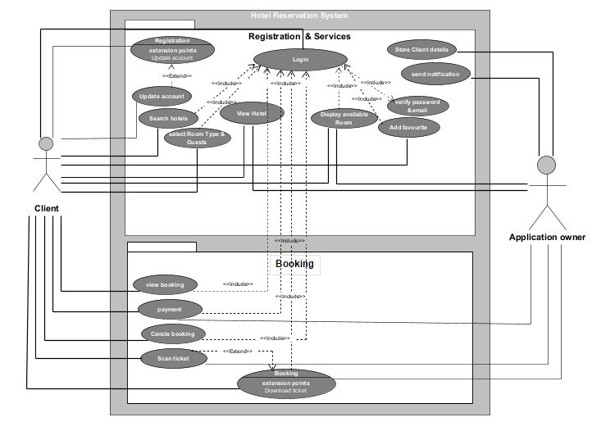
USE CASE
DIAGRAM

Slide 13
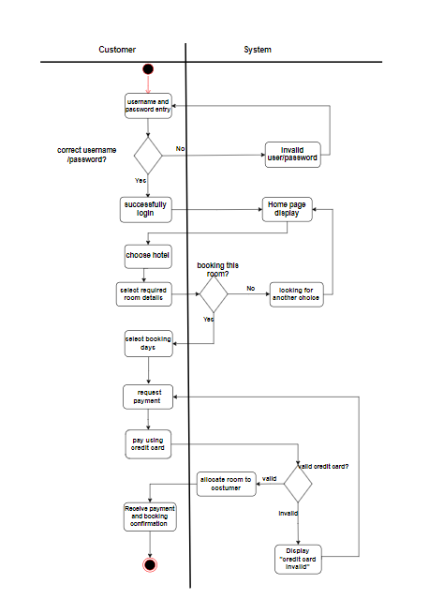
ACTIVITY
DIAGRAM

Slide 14
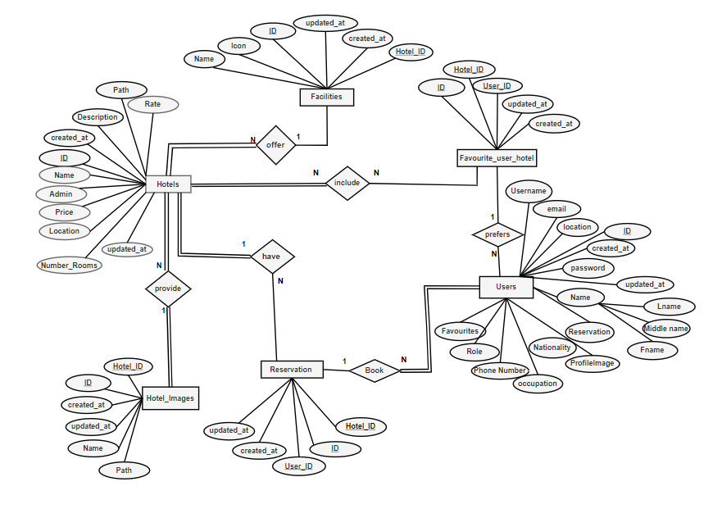
ER
DIAGRAM

Slide 15
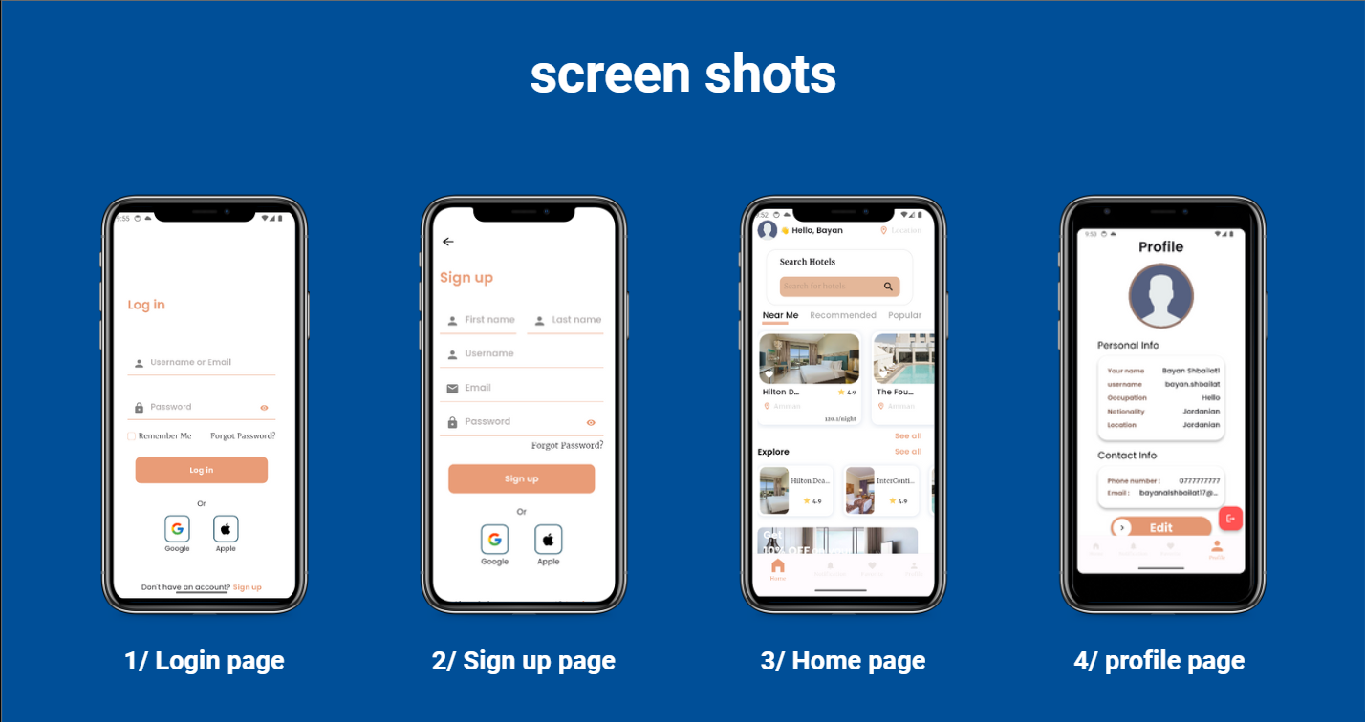

Slide 16


